Slide 1
Coronavirus Dataset Analysis
This presentation covers the importance of data analysis in understanding the impact of COVID-19. It covers the description of the dataset, tools and libraries used, data loading, and cleaning, along with detailed explanations and code snippets for SQL queries to retrieve information such as total cases, death rates, and recovery rates by country. The presentation also includes visualization of results for better understanding of the data. The conclusion summarizes the key insights from the analysis and reiterates the importance of data-driven decision making.
Make by : Pratham patel
Source code : https://github.com/PATELPRATHAM007/Mentorness_MPI-DA-11

Slide 2
Coronavirus Dataset Analysis
To solve the SQL queries, I used pandas and pandasql libraries in Python

Slide 3
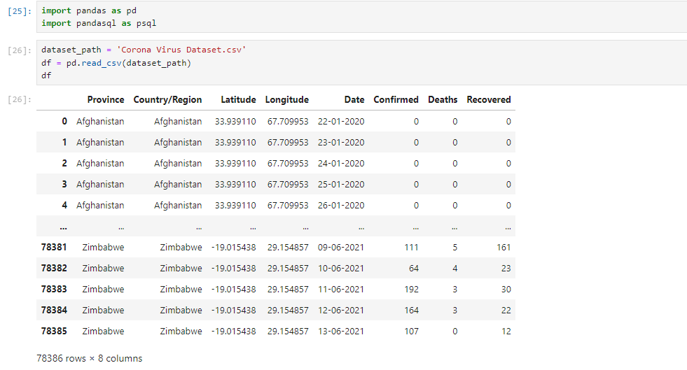
Import library and add csv file

Slide 4
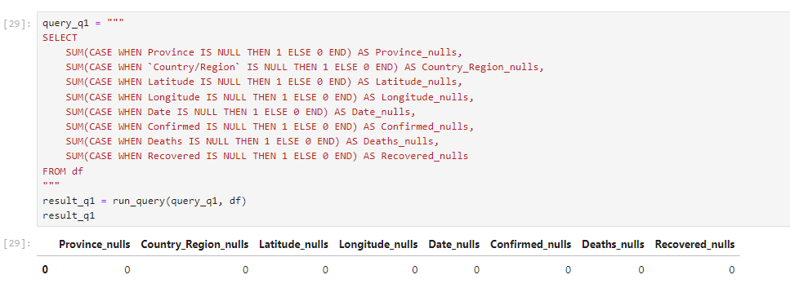
Query :- 1
Q1. Write a code to check NULL values

Slide 5
Query :- 2
If NULL values are present, update them with zeros for all columns.
Q2: Update NULL Values with Zeros Based on the results of the first query, we know that there are no NULL values in any of the columns in the dataset. Therefore, there is no need to execute query number 2, which would replace NULL values with zeroes.
now we move on the 3ed query

Slide 6
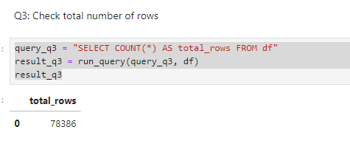
Query :- 3
check total number of rows

Slide 7
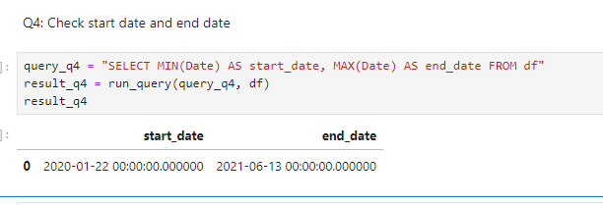
Query :- 4
Check what is start_date and end_date

Slide 8
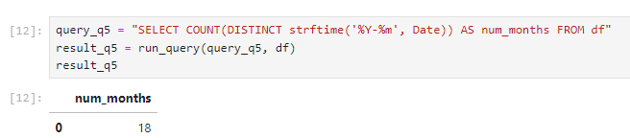
Query :- 5
Q5. Number of month present in dataset

Slide 9
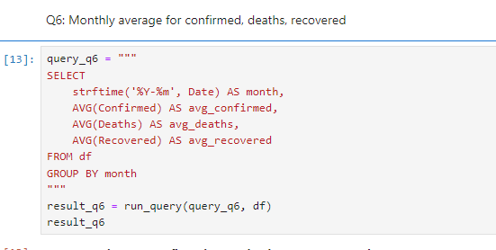
Query :- 6
Q6. Find monthly average for confirmed, deaths, recovered

Slide 10
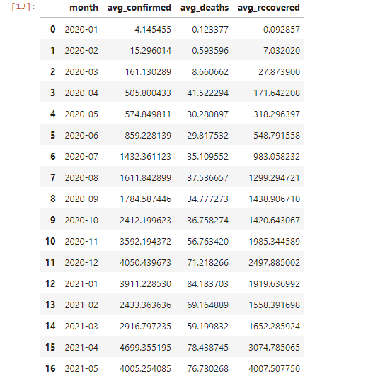

Slide 11
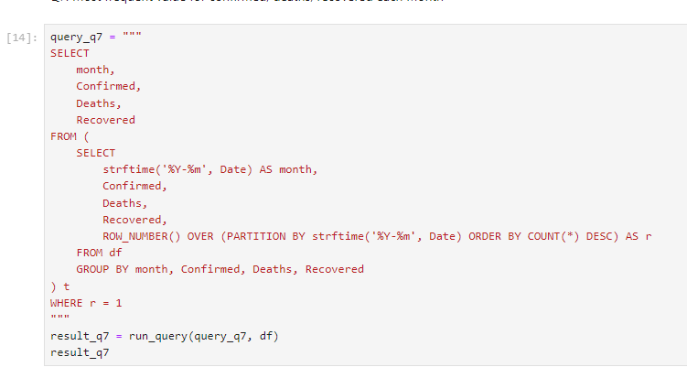
Query :- 7
Q7. Find most frequent value for confirmed, deaths, recovered each month

Slide 12
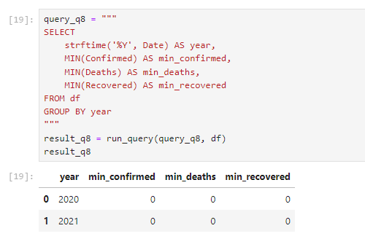
Query :- 8
Q8. Find minimum values for confirmed, deaths, recovered per year

Slide 13
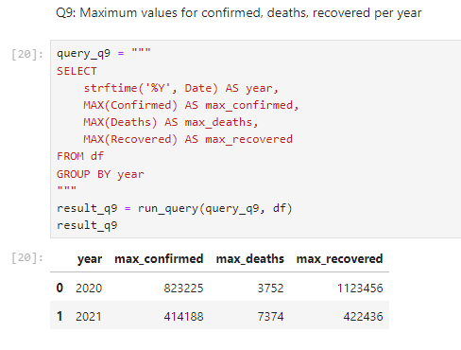
Query :- 9
Q9. Find maximum values of confirmed, deaths, recovered per year

Slide 14
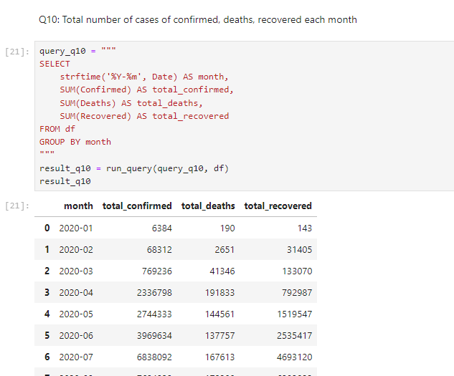
Query :- 10
Q10. The total number of case of confirmed, deaths, recovered each month

Slide 15
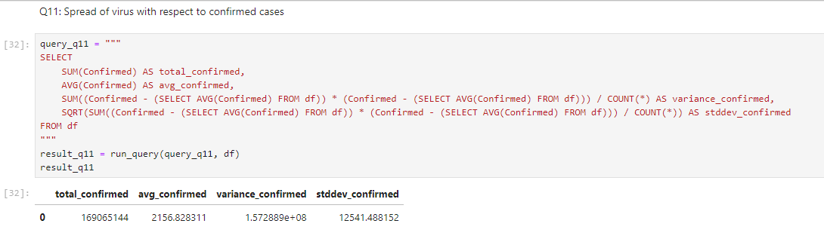
Query :- 11
Q11. Check how corona virus spread out with respect to confirmed case

Slide 16
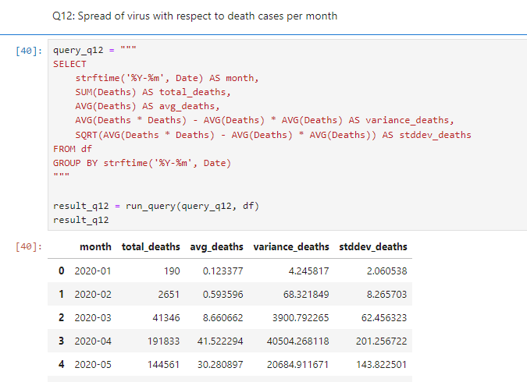
Query :- 12
Q12. Check how corona virus spread out with respect to death case per month

Slide 17
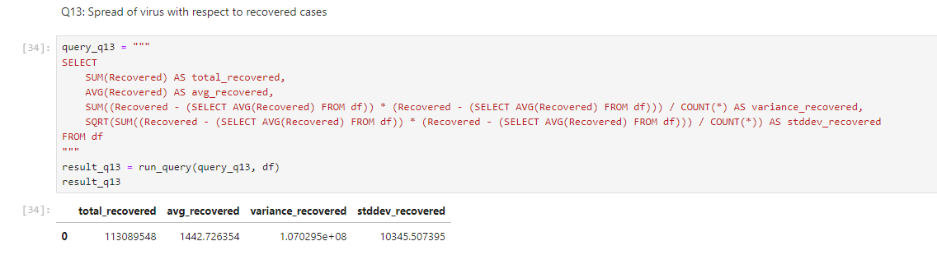
Query :- 13
Q13. Check how corona virus spread out with respect to recovered case
-- (Eg.: total confirmed cases, their average, variance & STDEV )

Slide 18
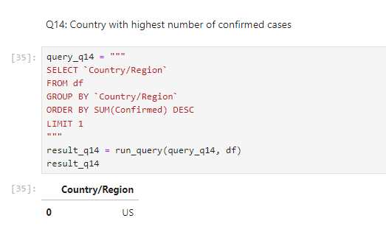
Query :- 14
Q14. Find Country having highest number of the Confirmed case

Slide 19
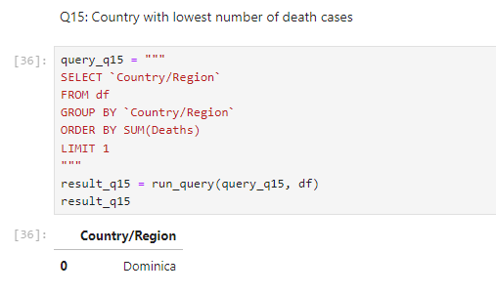
Query :- 15
Q15. Find Country having lowest number of the death case

Slide 20
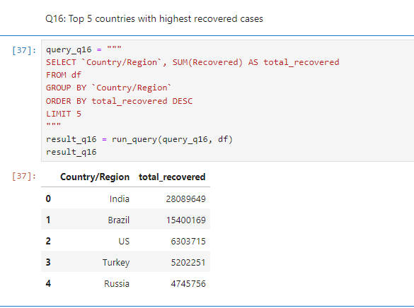
Query :- 16
Q16. Find top 5 countries having highest recovered case

